Slide 1

Final Presentation
Research:
Capability Of
TIBCO Platform
By: Tan Wei Jun, Terris
FYPJ 2019 Semester 1 Period 2

Slide 2
Recap

Slide 3














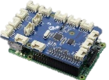







(Recap)
Previously…
NYP And TIBCO Background
TIBCO Spotfire Application
VS-2015 WinForm Projects

Slide 4
Objective (Recap)
Document Research
Create Demos
Encounter Problems To Solve Solutions
Final Conclusion On TIBCO

Slide 5



Project Overview (Recap)
Explore TIBCO Spotfire
Create Demo Applications
Connect Spotfire with Demo App

Slide 6

Project Overview (Recap)
Explore TIBCO Spotfire
Create Demo Applications
Connect Spotfire with Demo App
Introduce IoT technology

Slide 7
End Of Recap

Slide 8

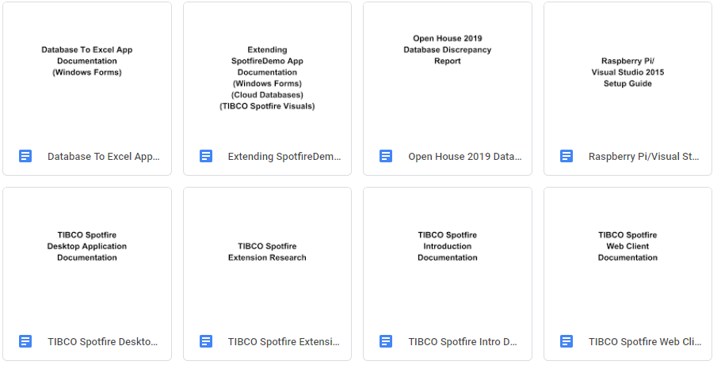
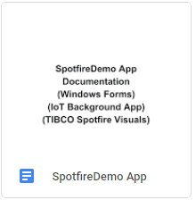
Documentations

Slide 9

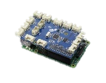



Finals Achievements
OH2019
Spotfire Demo
IoT Spotfire

Slide 10


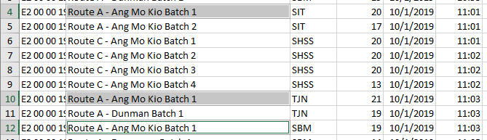


Tasks Per Week
Week 7
NYP OH2019 Database Cleaning
Examples
Incorrect Time Stamp
Tour Cancellation With Inputs
Same route but time interval is obviously too close
An input when tour cancelled
Invalid Arrival and Departure Time
Missing End Time
Time_Arr is larger than Time_Dep
Has Time_Arr but no Time_Dep
Missing Time_End
Others
The SIT stop is obviously too early, and the student arrivals is zero.
And Many More…

Slide 11
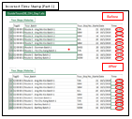
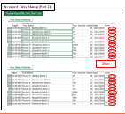
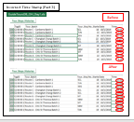
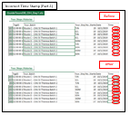
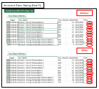
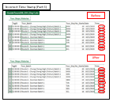
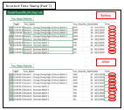
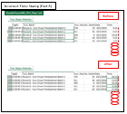



NYP OH2019 Examples
Much More Examples…
Scrapped

Slide 12
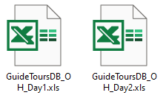
Tasks Per Week
Week 8
Final OH2019 Database Cleaning
Improved/Added
New Spotfire OH2019 Visuals

Slide 13








Tasks Per Week
Week 9
Added Multilingual Into WinForms & Spotfire Project
Not All Projects
Explored & Sourced For
Free Cloud Database Services
ThingSpeak

Slide 14


Cloud Service Giants Comparison
Vs
Free Monthly Usage Limit
Free 12
Month Trial
Free Tier Type
Simpler Learning Curve
Straight Forward Implementation
Easy To Setup

Slide 15
Cloud Service Giants Comparison
So is
a better option ?
Not At All!

Slide 16
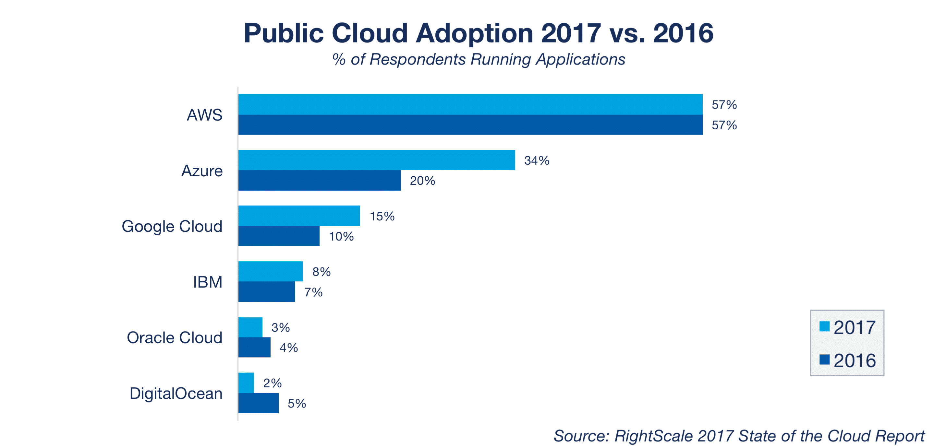
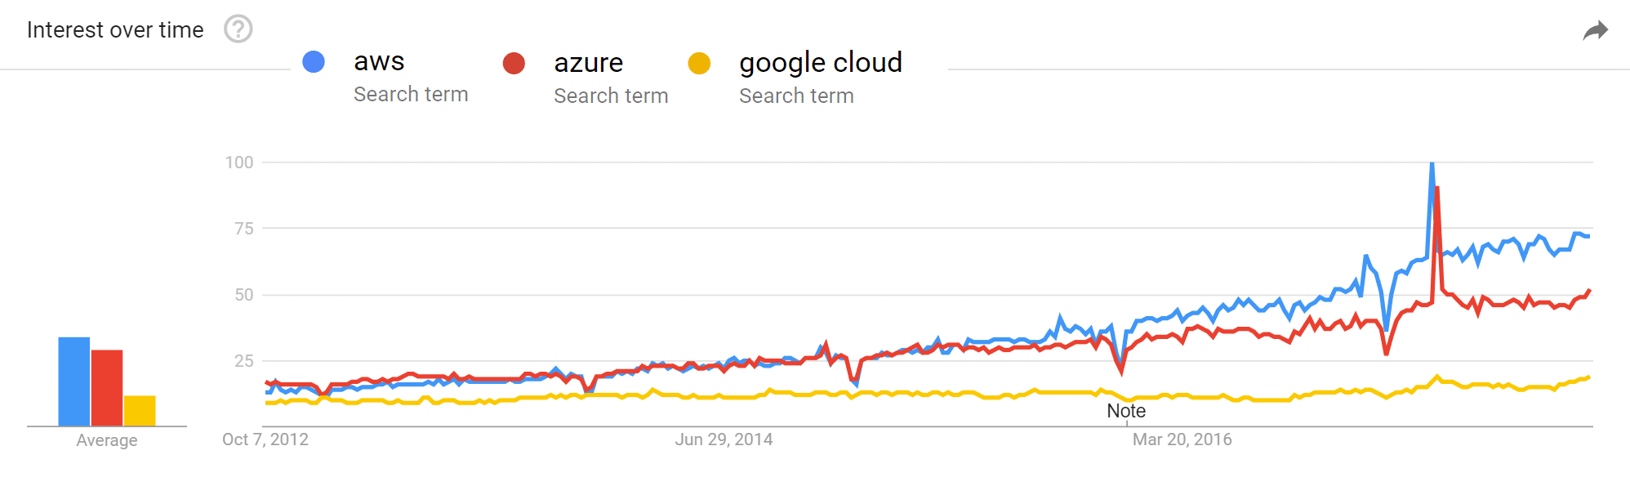
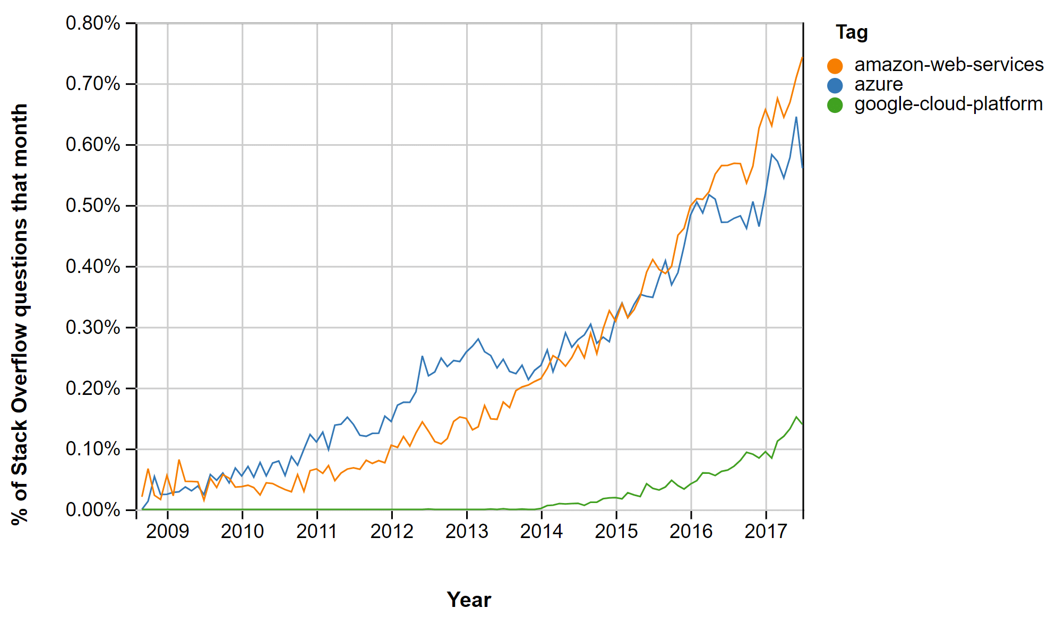
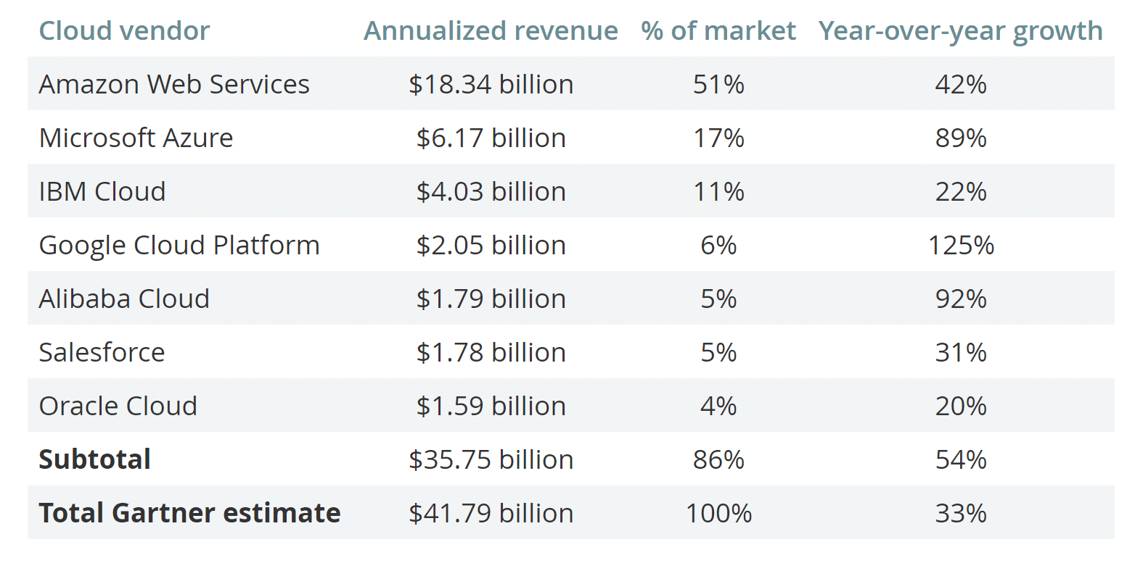
Cloud Service Giants Comparison
Research Online
Reference: https://kinsta.com/blog/google-cloud-vs-aws/

Slide 17






Tasks Per Week
Week 10
Created WinForms Demo With Google BigQuery
Attempted WinForms Demo With AWS RDS
School WiFi Blocks Default Port: 1433
Temporary Solution:
Use VPN or Personal Data

Slide 18



Tasks Per Week
Week 11
Continued Development AWS RDS Demo With VPN
Found Working Ports With School WiFi; 5222, 5223
Started Improvements On
IoT Spotfire Demo
Used AWS RDS Cloud Database

Slide 19







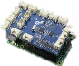




Tasks Per Week
Week 12
Completed IoT Spotfire Demo
Touched Up Overall Work
Presentation

Slide 20
Demo

Slide 21
IoT Demo
How It Works
1) Choose a Date, Time Slot, and Duration
2) Start-up IoT Background Application
- Light will turn Red
- Simulation has Started
3) Tap the correct card
- Light will turn Green
- Signals Student Arrival Time
4) To End Booking/Simulation
- Final Alarm Rings
- Manually Press Button (For Demo Purposes)

Slide 22
Final Conclusion On TIBCO Spotfire

Slide 23
Final Conclusion
Personal Opinion
Learning Curve is very Steep
A lot to offer at the beginning
Difficult to master
Conclusion
TIBCO Spotfire can be used as a beginner’s tool to start learning Analytics
Slowly introduced to impart into running projects and applications

Slide 24
End

Slide 25
Finals Q&A – Difficulties/Challenges
Week 7 – OH2019 Database Cleaning
Week 10 – AWS RDS Connection
Week 11 – IoT Demo Improvements

